Slide 1
Supplementary Material
Video Interpolation & Extrapolation

Slide 2
Introduction
Current video Interpolation methods (Super-SloMo, etc) can only interpolate short interval neighboring frames, e.g. 0.1s. Video extrapolation also can only predict next frame. These largely restrict their generalization ability and limit their application usage. In this project, we aim to jointly interpolate and extrapolate long-interval video, i.e. we target at interpolating neighboring frames in 1s long time and extrapolate 1s long future frames. By using multiple discriminators and the foreground-background separate generation strategy as well as the segmentation, we can generate natural image content especially the foreground posture regardless of large translation, scale-change and color change.

Slide 3
Methodology
Our model is composed of 4 parts.
VAE encode, which can encode the video residual information. Based on the Kulback-Leibler divergence limited Gaussian distribution latent vectors and sampling, we can predict multiple possibilities into the future and generate images with various contents.
A HRNet based background generation model, which receives images and segmentations and then interpolate/extrapolate RGB-frames and segmentation map.
A tracking-based foreground object generator. We use PANet to detect objects in the frames and then use Siamese-RPN++ to track those objects. Based on the tracking boxes and segmentations, we crop and mask the foreground objects out, then send them to a U-net to produce foreground objects and corresponding segmentations.
A composition model. We then use a U-net to combine the generated background and foreground. A capacity module is used to limit the number of generated foreground objects into 10.
Overview Architecture refers to next page.

Slide 4
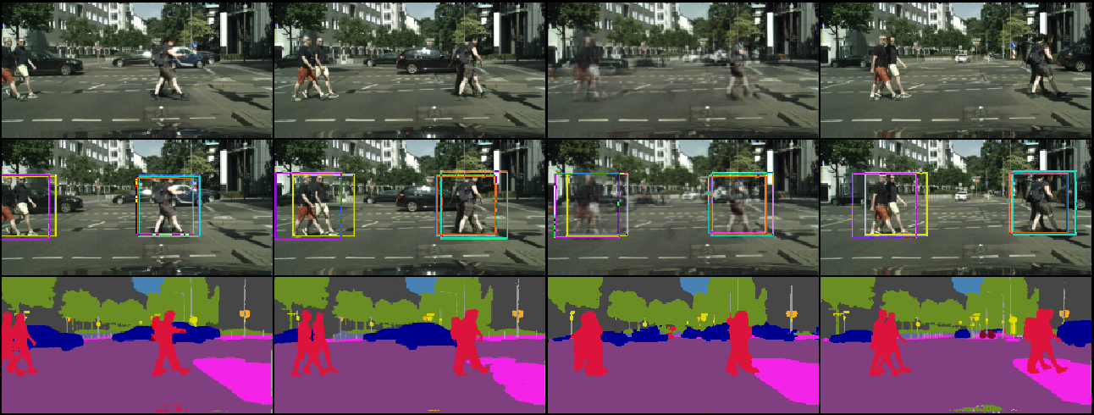
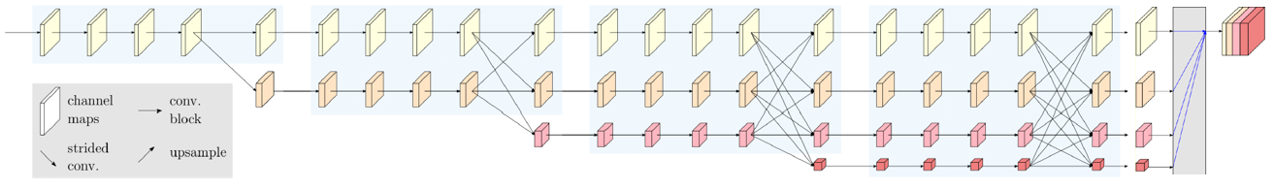
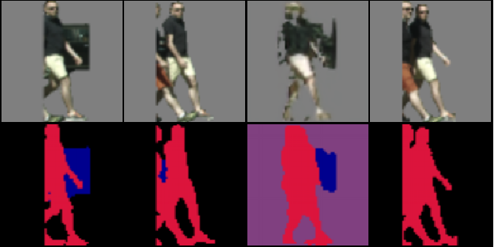
Real or Fake?
Real or Fake?
Video Discriminator
Frame Discriminator
HRNet
+
Skip Connection U-net
Residual Decoder
Background Generation Result
Composition (Final) Result
Crop and Mask
sampling
Real or Fake?
Content Discriminator
Skip Connection U-net
µ
ө
Crop and Mask
Foreground Generation Result
Video Encoder
Motion Discriminator
Real or Fake?

Slide 5
Comparison between Background Generation and Separate Generation

Slide 6
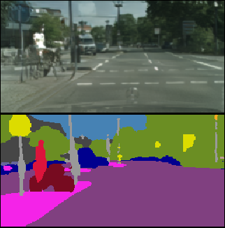
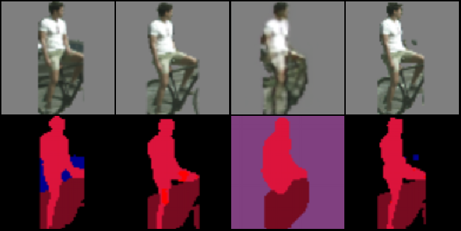
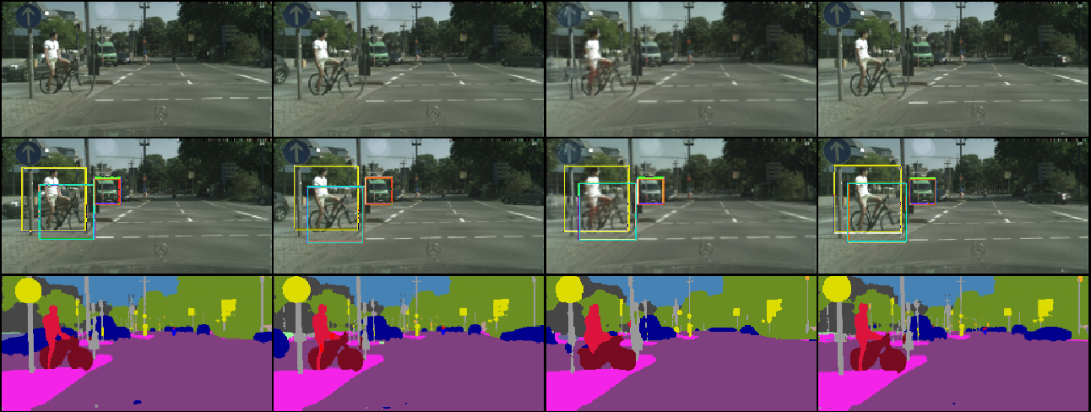
TrackNet 108
Background Result
E20-16
Input Foreground 1
Ground Truth Foreground
Foreground Generation Result
Input Foreground 2
Input Frame 1
Ground Truth
Composition Result
Input Frame 2

Slide 7
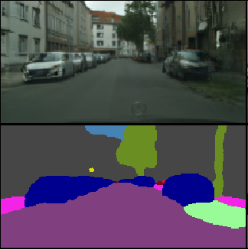
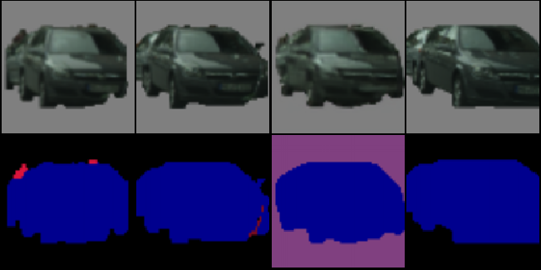
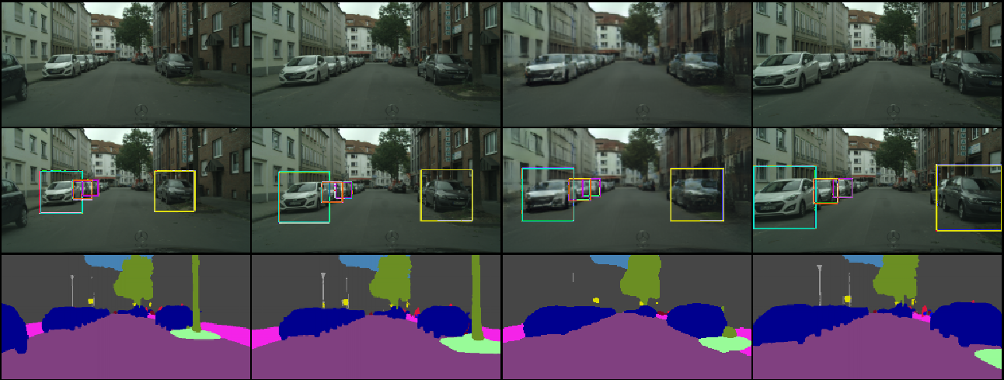
TrackNet 108
Background Result
E20-35
Input Foreground 1
Ground Truth Foreground
Foreground Generation Result
Input Foreground 2
Input Frame 1
Ground Truth
Composition Result
Input Frame 2

Slide 8
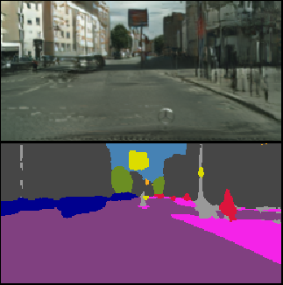
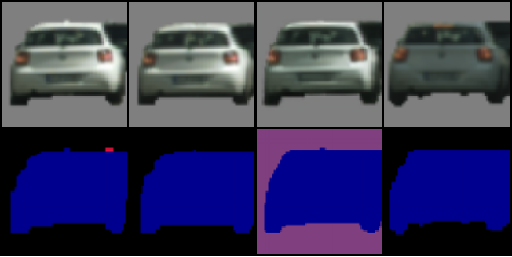
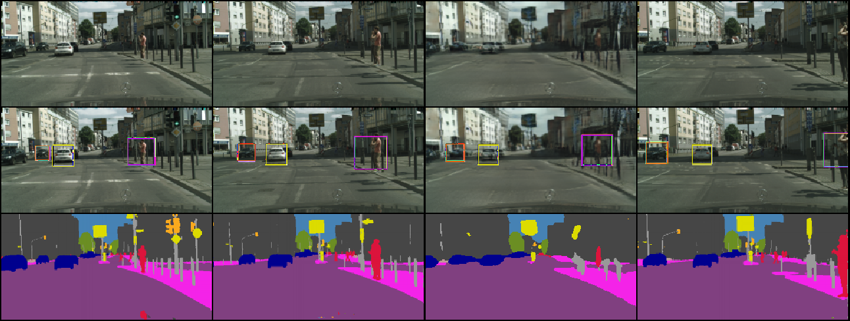
TrackNet 108
Background Result
Input Foreground 1
Ground Truth Foreground
Foreground Generation Result
Input Foreground 2
Input Frame 1
Ground Truth
Composition Result
Input Frame 2

Slide 9
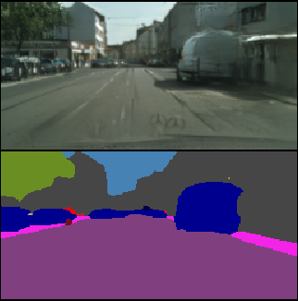
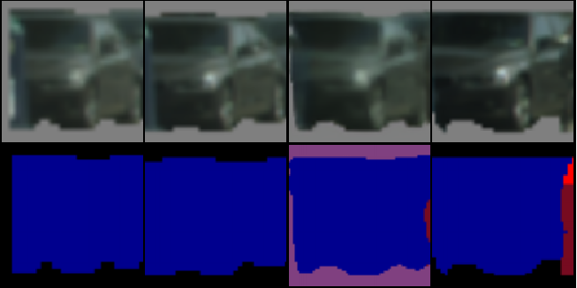
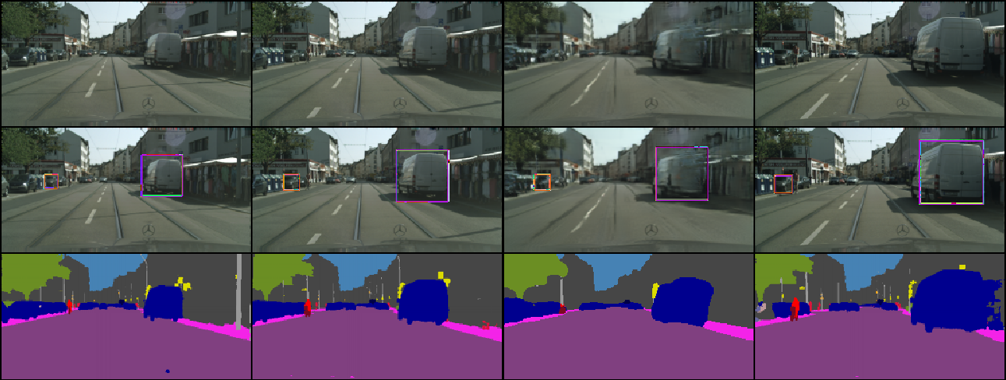
TrackNet 108
Background Result
E20-70
Input Foreground 1
Ground Truth Foreground
Foreground Generation Result
Input Foreground 2
Input Frame 1
Ground Truth
Composition Result
Input Frame 2

Slide 10
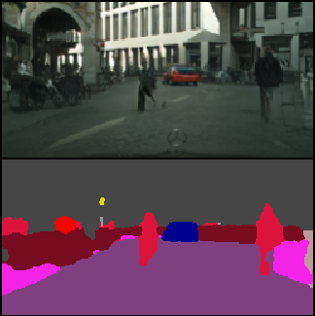
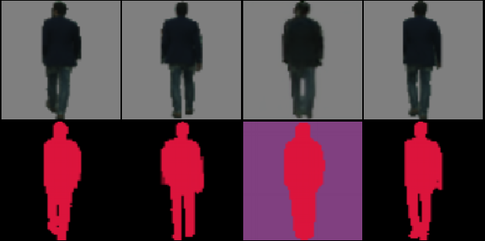
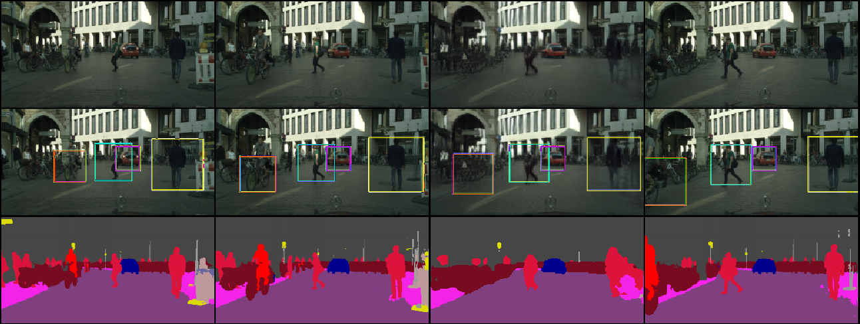
TrackNet 108
Background Result
E20-363
Input Foreground 1
Ground Truth Foreground
Foreground Generation Result
Input Foreground 2
Input Frame 1
Ground Truth
Composition Result
Input Frame 2

Slide 11
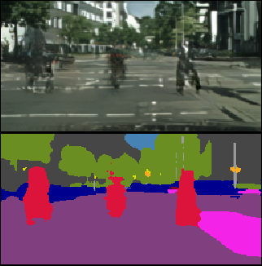
TrackNet 108
Background Result
Input Foreground 1
Ground Truth Foreground
Foreground Generation Result
Input Foreground 2
Input Frame 1
Ground Truth
Composition Result
Input Frame 2

Slide 12
Background Generation Qualitative Results

Slide 13
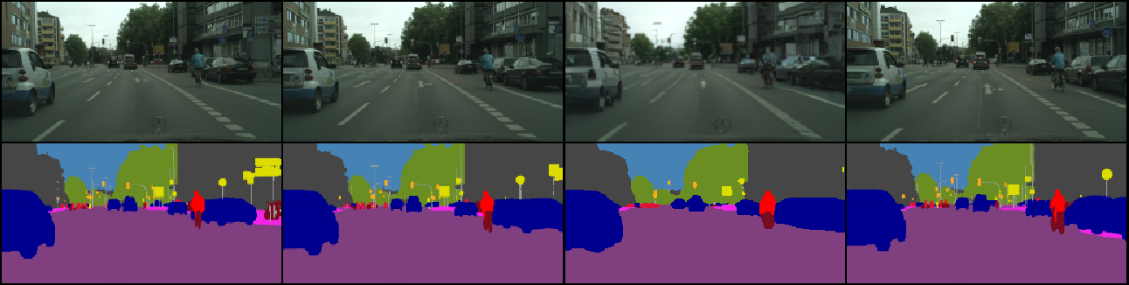
InterGANNet 1000
E30-12
Input Frame 1
Ground Truth
Background Generation Result
Input Frame 2

Slide 14
Foreground Generation Qualitative Results

Slide 15
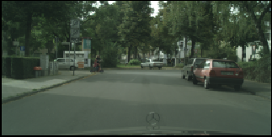
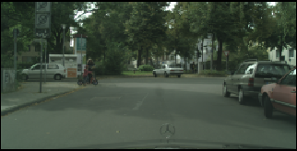
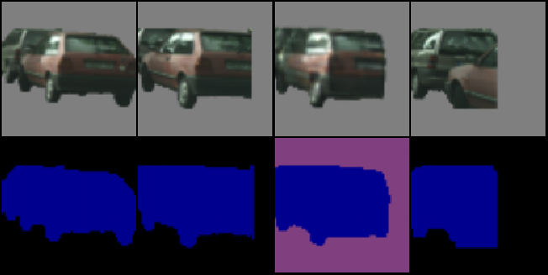
InterTrackNet 102
E20-1
Input Image 1
Input Image 2
Input Foreground 1
Ground Truth
Foreground Generation Result
Input Foreground 2

Slide 16
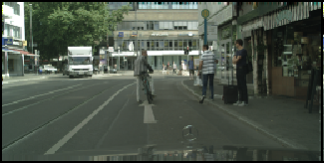
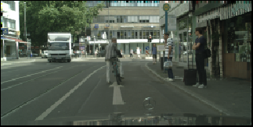
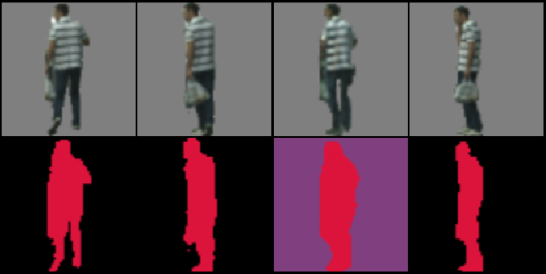
InterTrackNet 102
E20-11
Input Image 1
Input Image 2
Input Foreground 1
Ground Truth
Foreground Generation Result
Input Foreground 2

Slide 17
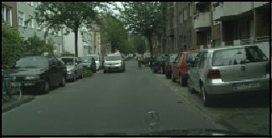
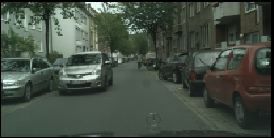
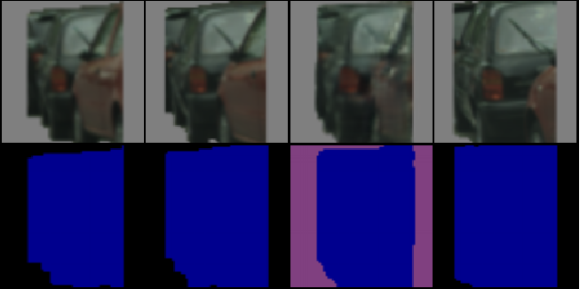
InterTrackNet 102
E20-18
Input Image 1
Input Image 2
Input Foreground 1
Ground Truth
Foreground Generation Result
Input Foreground 2

Slide 18
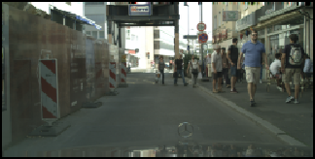
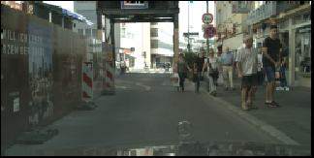
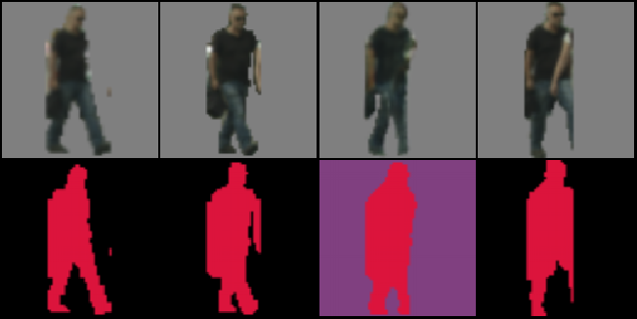
InterTrackNet 102
E20-27
Input Image 1
Input Image 2
Input Foreground 1
Ground Truth
Foreground Generation Result
Input Foreground 2

Slide 19
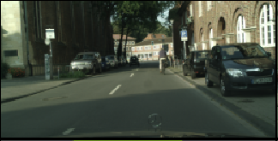
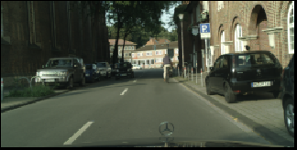
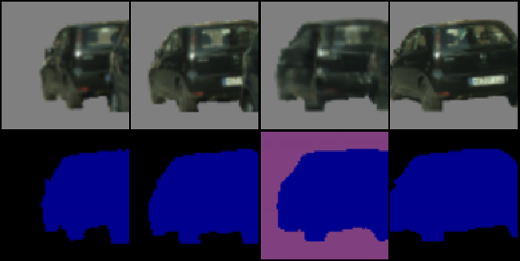
InterTrackNet 102
E20-56
Input Image 1
Input Image 2
Input Foreground 1
Ground Truth
Foreground Generation Result
Input Foreground 2

Slide 20
Separate Generating Model (Full Model) Qualitative Results

Slide 21
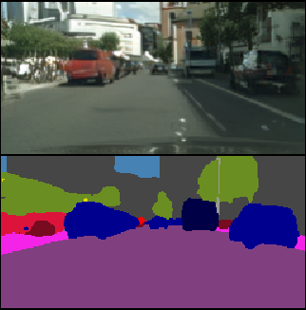
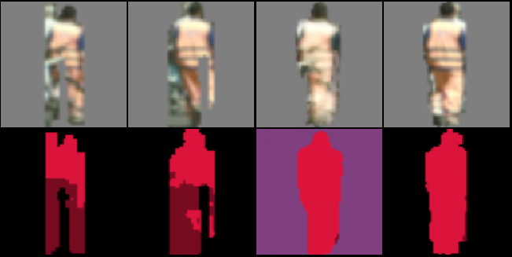
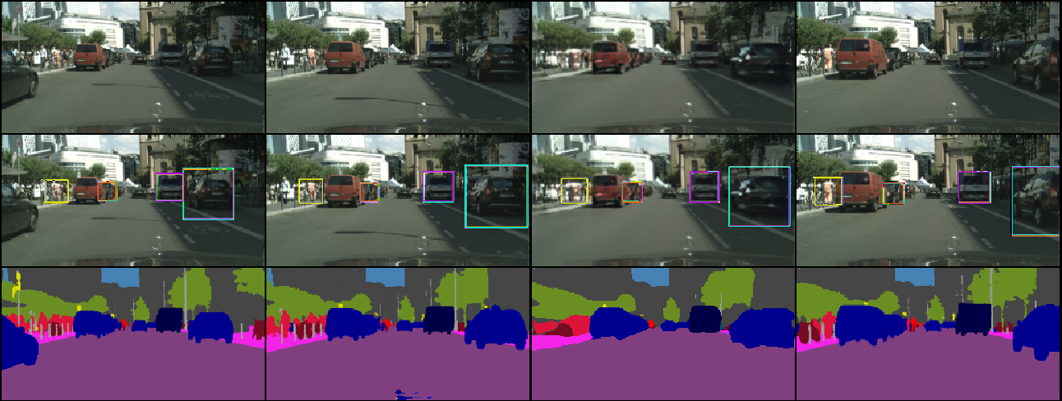
TrackNet 108
Background Result
E20-20
Input Foreground 1
Ground Truth Foreground
Foreground Generation Result
Input Foreground 2
Input Frame 1
Ground Truth
Composition Result
Input Frame 2

Slide 22
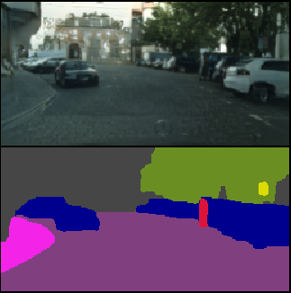
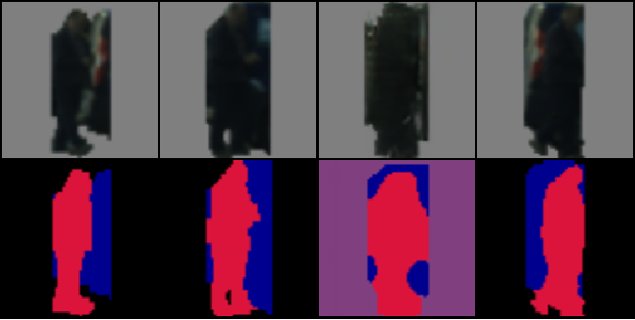
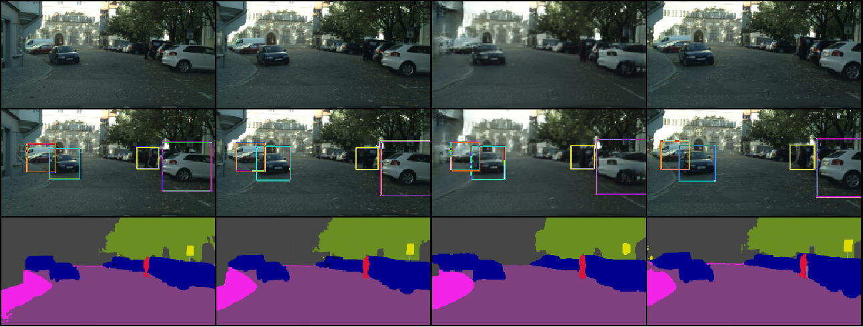
TrackNet 108
Background Result
E20-72
Input Foreground 1
Ground Truth Foreground
Foreground Generation Result
Input Foreground 2
Input Frame 1
Ground Truth
Composition Result
Input Frame 2

Slide 23
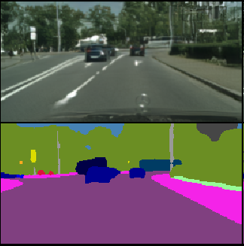
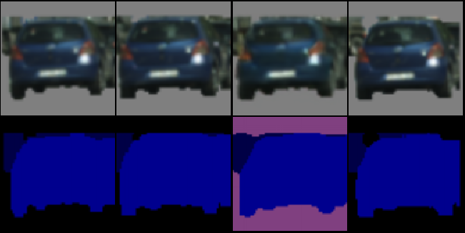
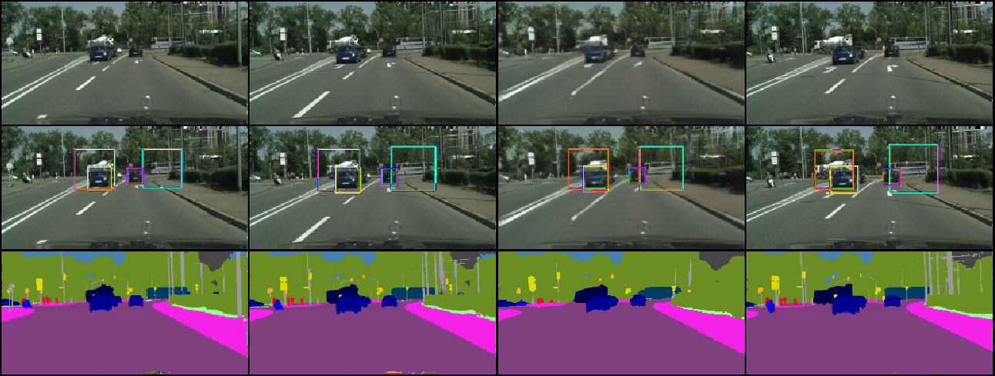
TrackNet 108
Background Result
E20-75
Input Foreground 1
Ground Truth Foreground
Foreground Generation Result
Input Foreground 2
Input Frame 1
Ground Truth
Composition Result
Input Frame 2

Slide 24
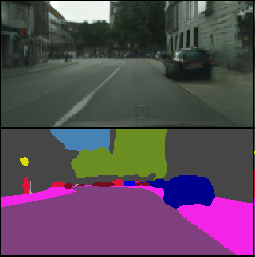
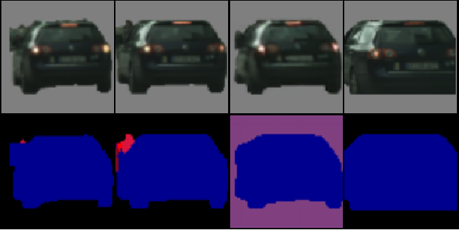
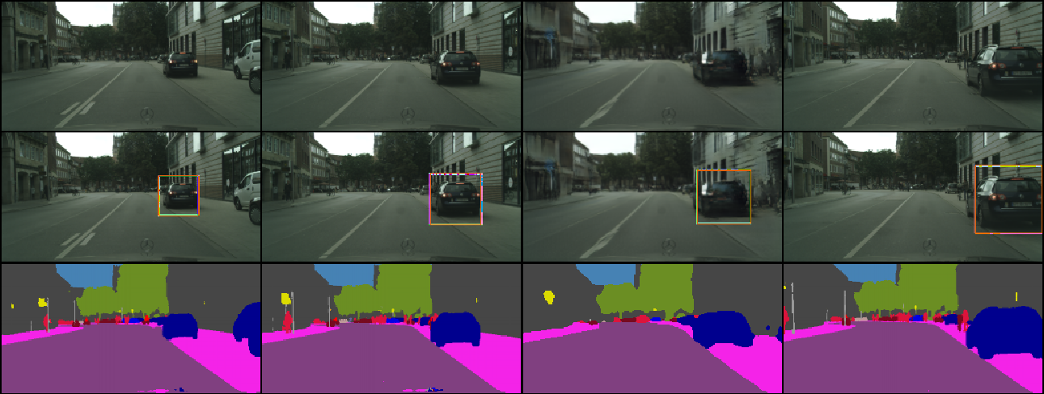
TrackNet 108
Background Result
E20-21
Input Foreground 1
Ground Truth Foreground
Foreground Generation Result
Input Foreground 2
Input Frame 1
Ground Truth
Composition Result
Input Frame 2

Slide 25
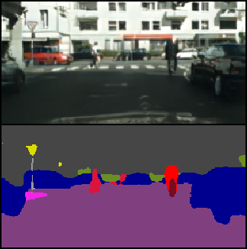
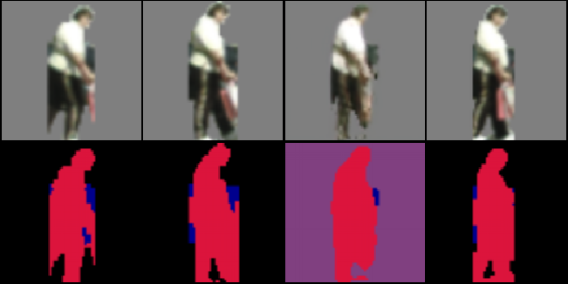
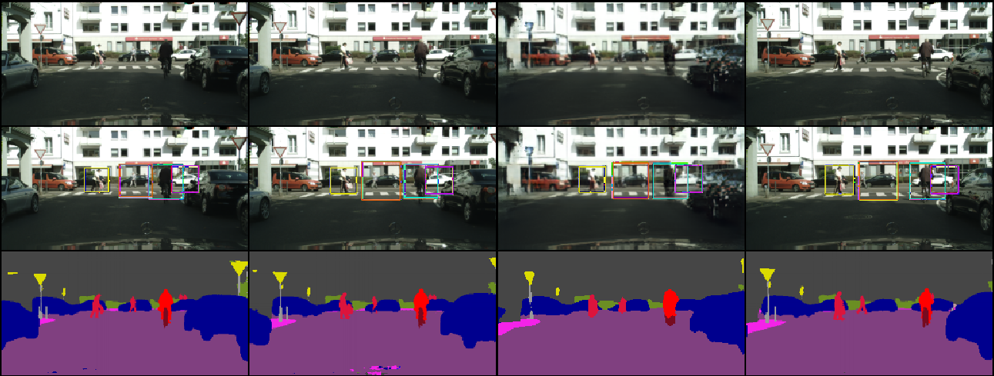
TrackNet 108
Background Result
E20-23
Input Foreground 1
Ground Truth Foreground
Foreground Generation Result
Input Foreground 2
Input Frame 1
Ground Truth
Composition Result
Input Frame 2

Slide 26



TrackNet 108
Background Result
E20-46
Input Foreground 1
Ground Truth Foreground
Foreground Generation Result
Input Foreground 2
Input Frame 1
Ground Truth
Composition Result
Input Frame 2

Slide 27



TrackNet 108
Background Result
E20-61
Input Foreground 1
Ground Truth Foreground
Foreground Generation Result
Input Foreground 2
Input Frame 1
Ground Truth
Composition Result
Input Frame 2

Slide 28



TrackNet 108
Background Result
E20-89
Input Foreground 1
Ground Truth Foreground
Foreground Generation Result
Input Foreground 2
Input Frame 1
Ground Truth
Composition Result
Input Frame 2

Slide 29



TrackNet 108
Background Result
E20-93
Input Foreground 1
Ground Truth Foreground
Foreground Generation Result
Input Foreground 2
Input Frame 1
Ground Truth
Composition Result
Input Frame 2

Slide 30



TrackNet 108
Background Result
E20-100
Input Foreground 1
Ground Truth Foreground
Foreground Generation Result
Input Foreground 2
Input Frame 1
Ground Truth
Composition Result
Input Frame 2

